Slide 1
Understanding Trauma, Behavioral, and Mental Health.

Slide 2
Understanding…
Trauma
Behavioral & Mental Health
Signs
Stress
Anxiety
Recovery
What is Trauma? What are the types and how to recognize?
Behavioral & Mental Health/Continuum.
Mental Health in the Workplace.
Understanding Stress, Anxiety and Recovery.

Slide 3
Definition of Trauma
The famous 3 “E’s” of trauma
An event, series of events that occurs, which leads to a set of circumstances that is experienced by persons, as physically or emotionally harmful or life threatening and that has lasting adverse effects.

Slide 4
Types of Trauma
Natural disasters: hurricanes, fires, floods
Human-caused disasters: accidents, wars, environmental disasters, acts of terrorism
Community violence: robberies, shootings, assault, gang-related violence, hate crimes, group trauma affecting a particular community
Family trauma: abuse, neglect, experiencing or witnessing domestic violence, incarceration of family members, family substance abuse, sudden or expected loss of a loved one
Medical trauma: pain, injury and serious illness; invasive medical procedures or treatments

Slide 5
Recognizing Trauma
Experiences become traumatic when we feel overwhelmed and unable to cope.
Traumatic experiences come in many forms, ranging from one-time events to experiences that are chronic or even generational.
Exposure to trauma in childhood that last through adulthood is common.
Risk for exposure to more than one type is high.

Slide 6
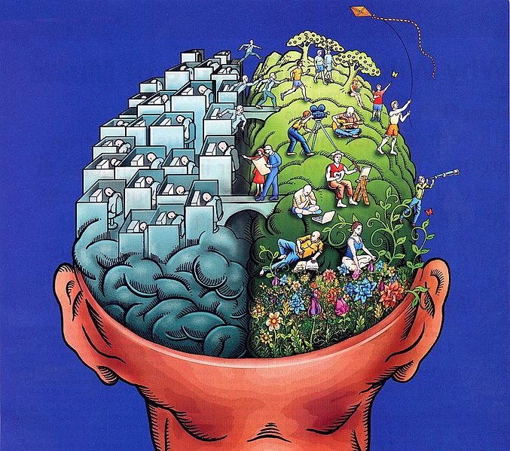
Impact of Trauma on Staff
Complaining of headaches, stomachaches, poor appetite, and decline in self-care
Intense feelings of fear, anxiety, and concern for their safety
Difficulty identifying feelings/controlling emotions
Angry or aggressive outbursts
Withdrawn from others
Engages in risk-taking behaviors
Trouble reading social cues and building healthy relationships

Slide 7
What does “it all” mean for my Behavioral & Mental health…

Slide 8
…the understated difference…
Defining mental health
“Mental health is a state of well being in which the individual realizes his or her own abilities, can cope with the normal stresses of life, can work productively and fruitfully and is able to contribute to his or her own community.
Mental illnesses…
Defined as “health conditions involving changes in emotion, thinking or behavior. Mental illnesses are associated with distress and/or problems functioning in social, work or family activities.
Behavioral Health
Behavioral health is the connection between health and well-being of the body, mind, and spirit – as a collective. Blanket term that includes mental health.

Slide 9
Mental Health
Mental health influences how we think and feel about ourselves and others, and how we interpret events
It affects our capacity to learn, to communicate and to form, sustain and end relationships
It also influences our ability to cope with change, transition and life events
Getting married
Having a baby
New job
Moving to a new house
Loss

Slide 10
Mental health is more than the absence of mental disorders…
Let's be extremely clear…
Everyone experiences challenges that may affect mental health; different degrees –
varying lengths of time…result of the normal ups and downs of life.
FACT: no diagnoses necessary - death or stress, for example, affect our mental health.
Mental health is an integral part of overall health, no health without mental health.
Mental health is determined by a range of socioeconomic, biological and
environmental factors

Slide 14
Mental health in the workplace
The Workplace
Can support and sustain positive mental health
Source of stress that contributes to the increase of mental health problems and illness
No workplace is immune from such risks
Do not limit your definition of occupational health and safety to only the physical
Mental health is just as important and must not be overlooked

Slide 15
Several Virgin Islands residents, in any given
week, are unable to work due to behavioral or
mental health challenges or illnesses.
Nationally, 1 in 3 workplace disability claims
are related to behavioral or mental health
problems or illnesses.

Slide 16
Stress
The degree to which one feels overwhelmed or unable to cope as a result of pressures that are unmanageable…
COVID – 19!

Slide 17
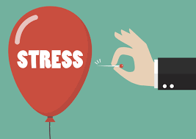
Stress is not a psychiatric diagnosis, but it's closely related to your mental health
Stress can be the cause mental health problems
Make existing problems worse.
The struggle to manage feelings of tension, you might develop a mental health problem like anxiety or depression.
Mental health imbalances can cause stress.
Coping with day-to-day symptoms of a mental health challenge, as well as potentially needing to manage/juggle medication, appointments or treatments, can become extra sources of stress.

Slide 18
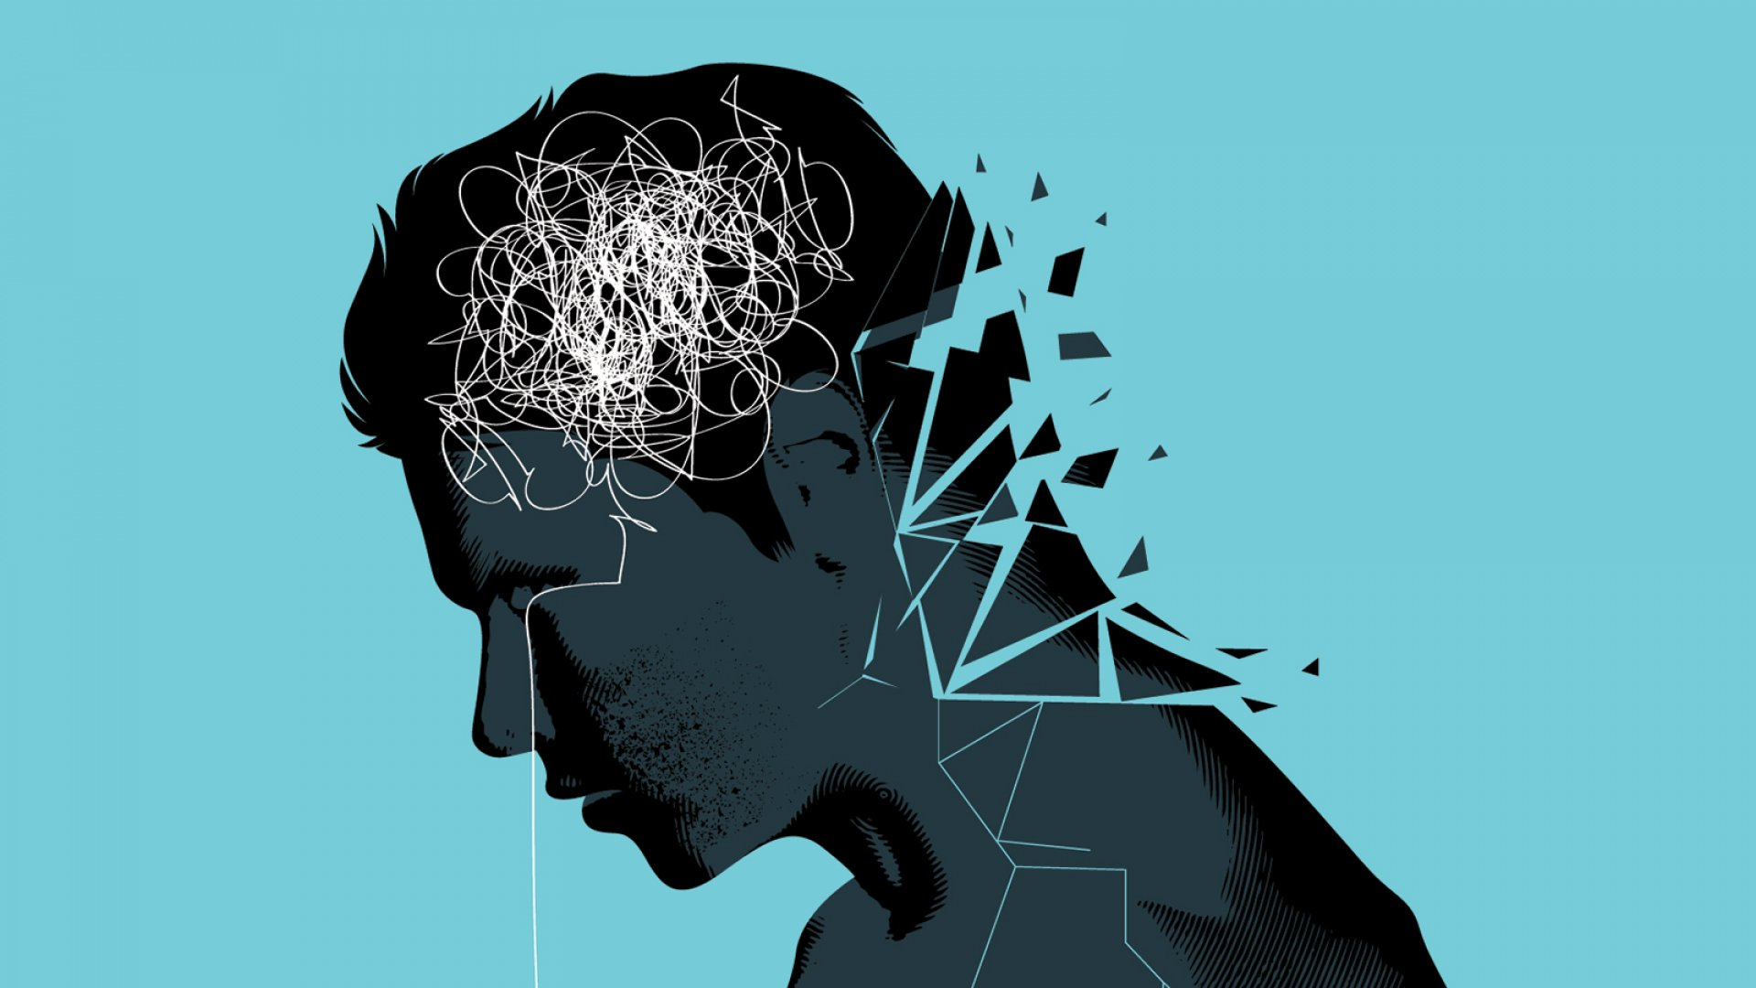
Anxiety
The term anxiety refers to feelings of worry, nervousness, apprehension, or fear commonly experienced by people when faced with something they view as challenging.

Slide 20
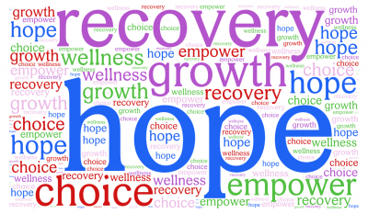
Recovery is about building a meaningful and
satisfying life, whether there are recurring or
ongoing symptoms or mental health problems.
The key themes of recovery are Agency-
gaining a sense of control over one's life and
one's illness.

Slide 21
