Slide 1
Virgin Islands Territorial Emergency Management Agency
What it is
&
What to do!
Emergency Preparedness Presentation

Slide 2
Presenters
Barbara A. Petersen, Assistant Director
Regina Browne, Deputy Director of Planning and Preparedness
Lisa Ann James, Emergency Management Outreach Coordinator
Aesha Rivers, Territorial Emergency Planning Coordinator
Bria Ward, Administrative Officer II
Meghan Beda, Media and Content Writer

Slide 3
Agenda
Who We Are
Planning & Preparedness Division
Hurricane Preparedness
Earthquake Preparedness
Tsunami Preparedness
Active Shooter
CERT
Alert VI
Additional
Information

Slide 4
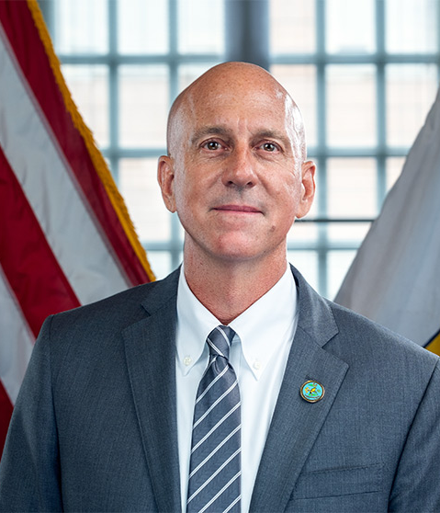
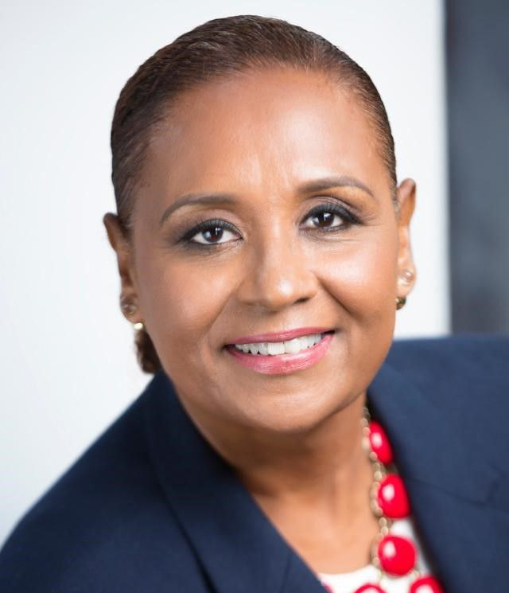
Who We Are
VITEMA is the agency with the primary responsibility for ensuring the Territory’s resilience to disasters.
The principal mission of VITEMA as a first response coordinator is to SAVE LIVES and PROPERTY of the Territory’s population.
Daryl D. Jaschen
Director
Barbara A. Petersen
Assistant Director

Slide 5
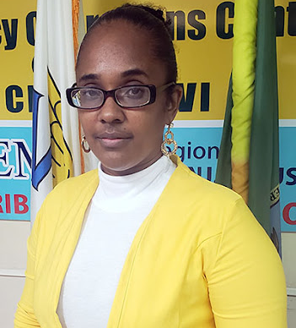
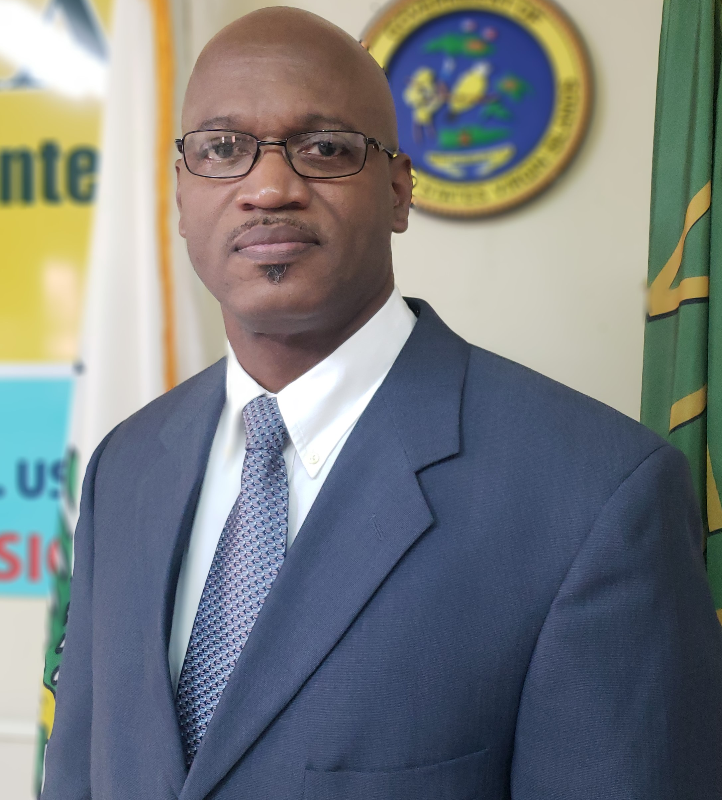
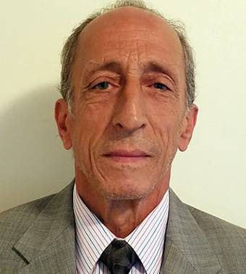
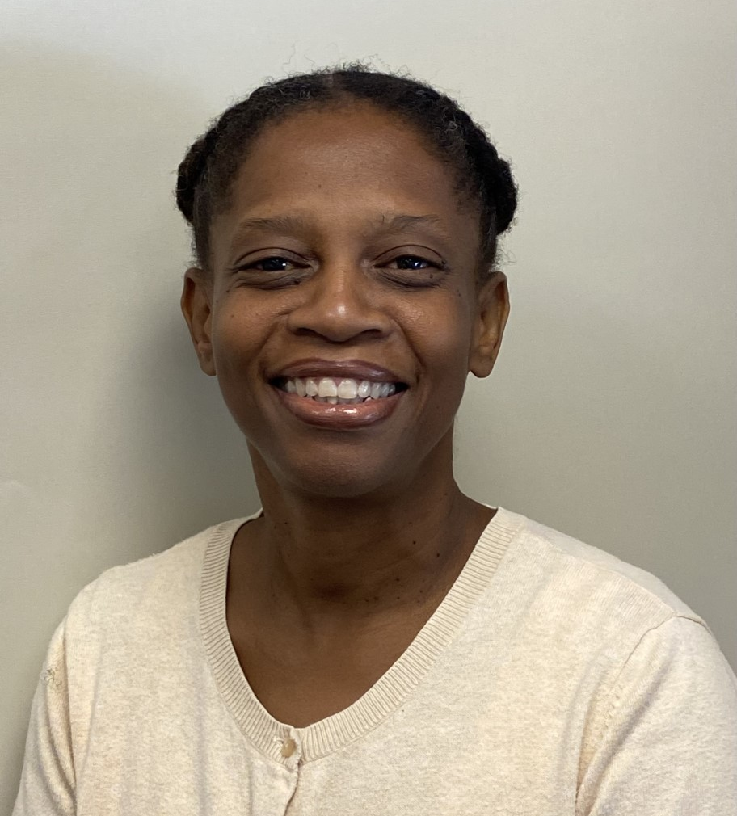
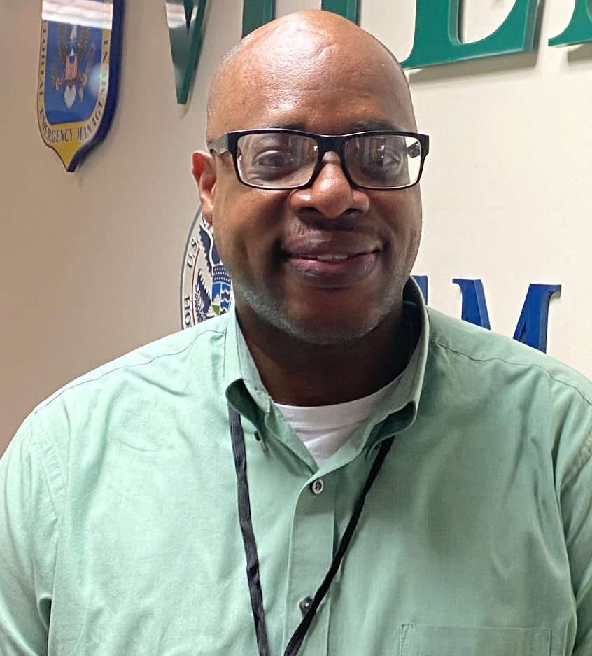
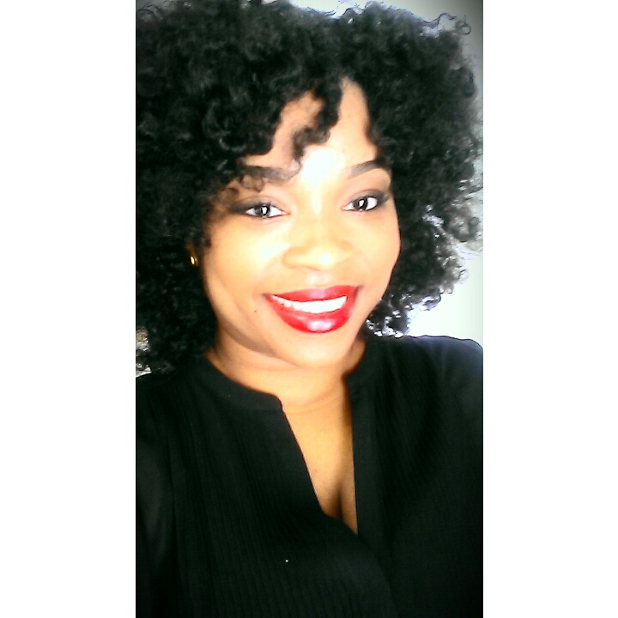
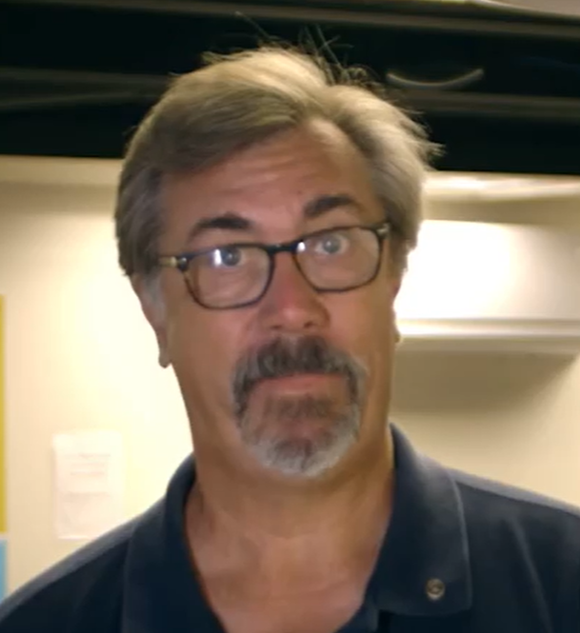
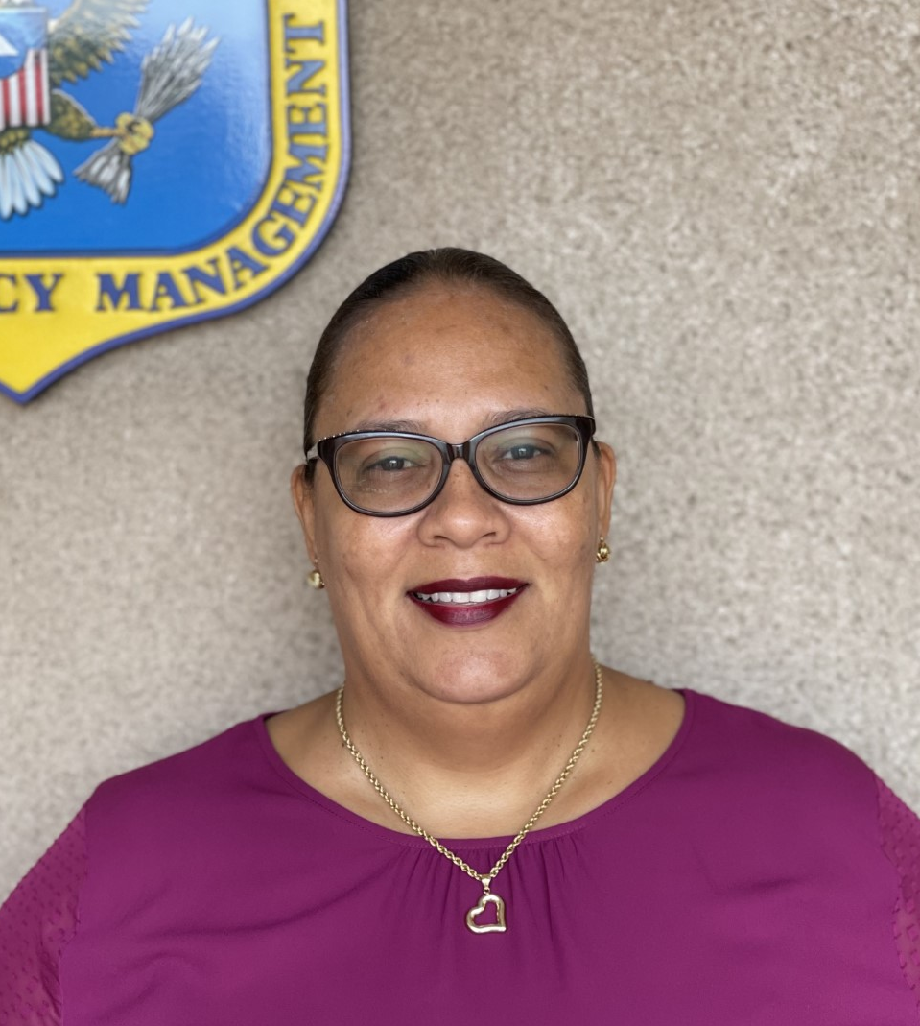
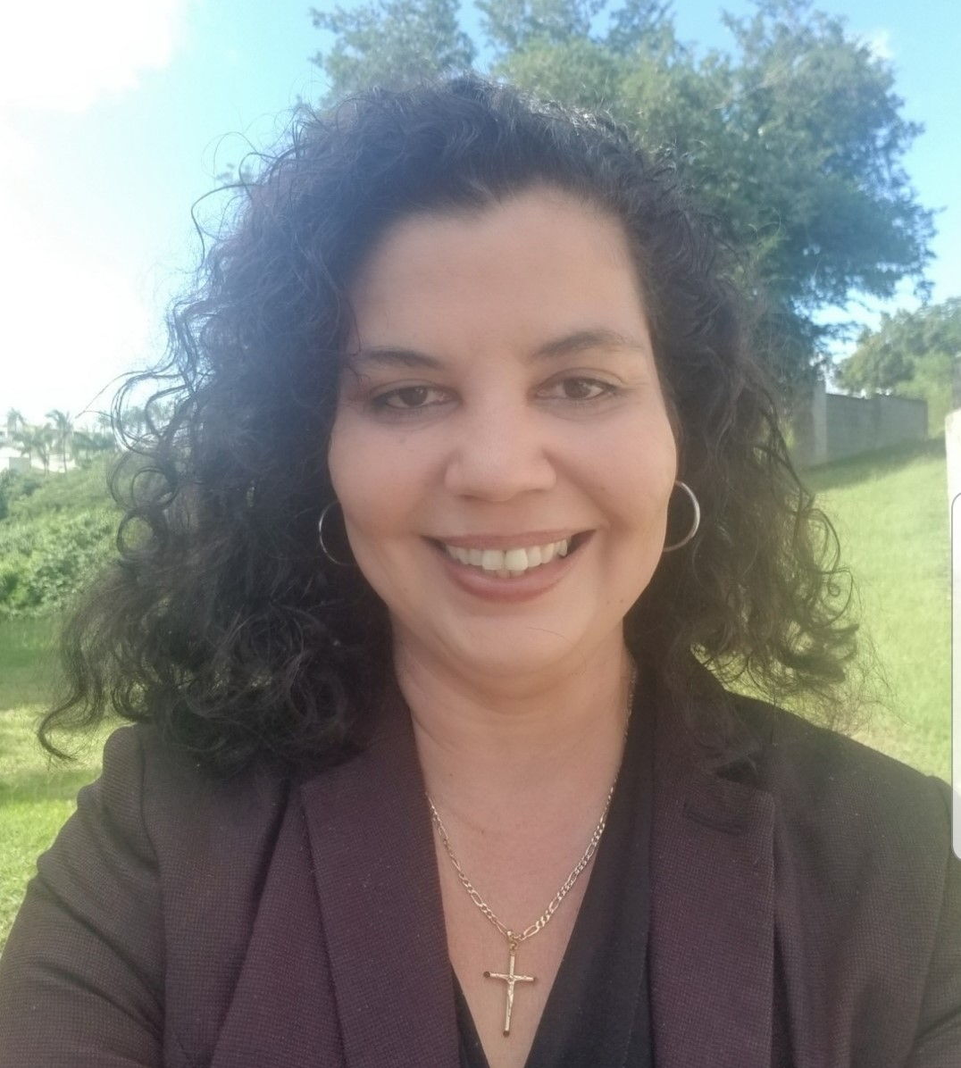
Who We Are
Regina Browne
Deputy Director of
Planning & Preparedness
Bruce Kelly
Deputy Director of
Operations
Steve DeBlasio
Deputy Director of
Logistics
Florecita Brunn
Deputy Director of
Grants Management
Winston Simon
Deputy Director of
Admin. & Finance
Merlinda Philomene
Deputy Director of
HR and LR
Erik Ackerson
Public Information Officer
Wayne Bryan
Fusion Center Manager
Malinda Vigilant-Messer
Territorial Public
Assistance Officer
Graciela Rivera
Hazard Mitigation
Programs Manager

Slide 6
Planning and Preparedness Division
Develops and exercises the Territorial Emergency Operations Plan (TEOP).
Identifies priorities in the community and recommends areas to address gaps.
Organizes and conducts training, exercises and public education.

Slide 7
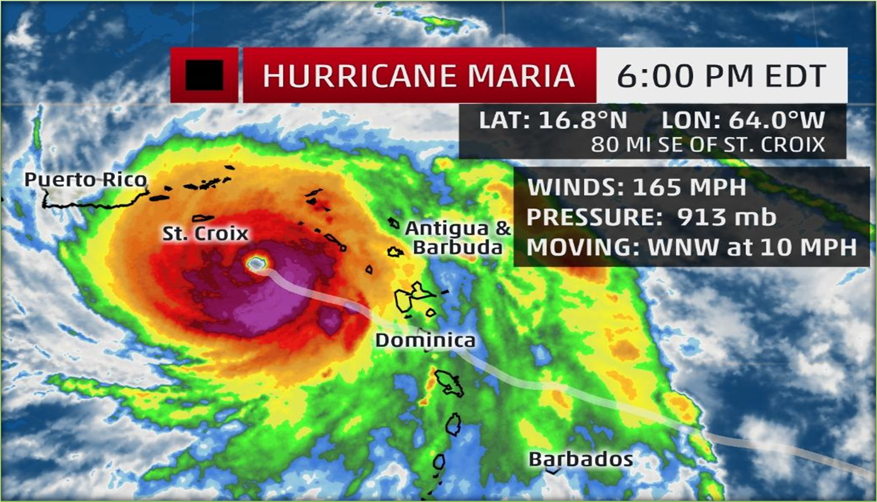
What is a Hurricane?
A tropical cyclone with winds of 74 miles per hour or greater that is usually accompanied by rain, thunder and lightning.
There are five types of categories of hurricanes based on their wind speed. The scale of categories is called the Saffir-Simpson Hurricane Scale.
Category 1: Winds 74 - 95 mph – Some Damage
Category 2: Winds 96 - 110 mph – Extensive Damage
Category 3: Winds 111 - 129 mph – Devastating Damage
Category 4: Winds 130 - 156 mph – Catastrophic Damage
Category 5: Winds more 157 mph – Catastrophic Damage
The Atlantic Hurricane Season runs from June 1 to November 30, though the peak period is from the beginning of August through the end of October.

Slide 8
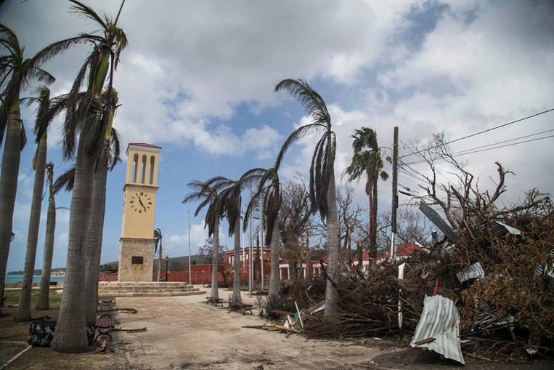
What to do
before a Hurricane?
Check your storm shutters
Repair / strengthen weak areas of your home
Check home insurance policy
Take pictures of your property. (home, vehicle, contents, etc.)
Trim trees around the property
Secure outdoor furniture
Have generator checked

Slide 9
What to do before a Hurricane?

Slide 10
What to do during & after a Hurricane
Pay attention to emergency information and alerts.
Determine how best to protect yourself from high winds and flooding.
Stay informed-Listen to local officials for information and special instructions.​
Be careful during clean-up. Wear protective clothing, use appropriate face coverings or masks if cleaning mold or other debris, and maintain a physical distance of at least six feet while working with someone else.
Do not touch electrical equipment if it is wet or if you are standing in water. If it is safe to do so, turn off electricity at the main breaker or fuse box to prevent electric shock.​
Avoid stepping or driving in flood water, which can contain dangerous debris.
TEXT! Phone systems are often down or busy after a disaster. Use text messages or social media to communicate with family and friends.
Check on your family and friends.
Notes:
People with asthma and other lung conditions and/or immune suppression should not enter buildings with indoor water leaks or mold growth that can be seen or smelled, even if they do not have an allergy to mold. Children should not take part in disaster cleanup work. Wear protective clothing and work with someone else.
Underground or downed power lines can also electrically charge the water.
Continue taking steps to protect yourself from COVID-19 and other infectious diseases, such as washing your hands often and cleaning commonly touched surfaces.
Many people may already feel fear and anxiety about the coronavirus 2019 (COVID-19). The threat of a hurricane can add additional stress. Follow CDC guidance for managing stress during a traumatic event and managing stress during COVID-19. You may need to talk to someone about your feelings, too. Don’t be afraid to reach out to friends, family, or professionals if you need help coping with your stress, anxiety, or sadness.

Slide 11
Family Plan
Set up a family meeting place. Pick at least two places to meet your family.
Meet outside your home in case of an emergency or at a friend’s or neighbor’s house in case you can’t return home.
Be sure that everyone know the address and phone numbers for each of your meet-up locations.

Slide 12
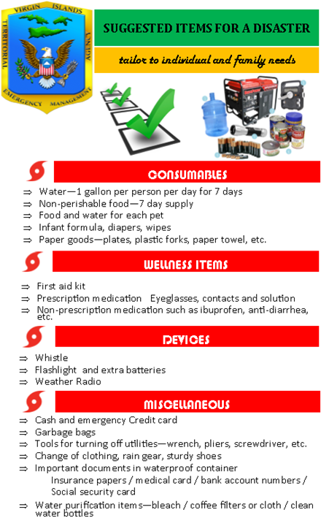
Disaster Kit
Clothes and shoes
Extra set of car keys
Blanket or sleeping bag
Emergency contact numbers
Non-perishable food
Sanitation supplies
Water
Family board games
Masks
Hand Sanitizer
Cash
First aid kit
Flashlight
Radio with extra batteries
Baby supplies
Medication

Slide 13
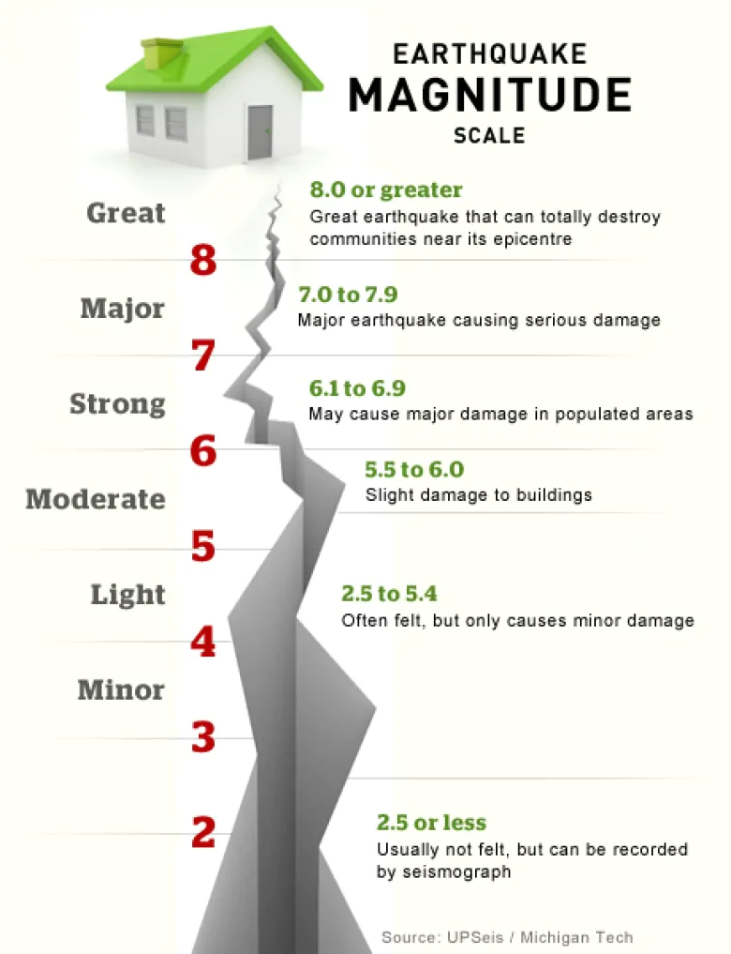
What is an Earthquake?
An earthquake is the sudden, rapid shaking of the earth, caused by the breaking and shifting of subterranean rock as it releases strain that has accumulated over a long time. Initial mild shaking may strengthen and become extremely violent within seconds.
Aftershocks, may follow the initial earthquake. Most are smaller than the initial earthquake, but larger magnitude aftershocks also occur.
Earthquakes may cause household items to fall, buildings to move, damage utilities and roads.
Earthquakes may also trigger landslides, avalanches, and tsunamis.
Earthquakes can happen at any time of the year and occur without warning.

Slide 14
What To Do
Before an earthquake occurs:
Secure items that could fall or move and cause injuries or damage (e.g., bookshelves, mirrors, televisions, computers). Move beds or other places people sit or lie on. Practice how to Drop, Cover, and Hold On!
During an earthquake:
Drop, Cover, and Hold: Drop down onto your hands and knees so the earthquake doesn’t knock you down. Drop to the ground (before the earthquake drops you!). Cover your head and neck with your arms to protect yourself from falling debris.
After an earthquake occurs:
When the shaking stops, look around. If the building is damaged and there is a clear path to safety, leave the building and go to an open space away from damaged areas.
Notes:
Stay away from glass, windows, outside doors and walls, and anything that could fall, such as light fixtures or furniture. Hold on to any sturdy covering so you can move with it until the shaking stops. Stay where you are until the shaking stops. Do not run outside
If you are trapped, do not move about or kick up dust. If you have a cell phone with you, use it to call or text for help. Tap on a pipe or wall or use a whistle, if you have one, so that rescuers can locate you.

Slide 15
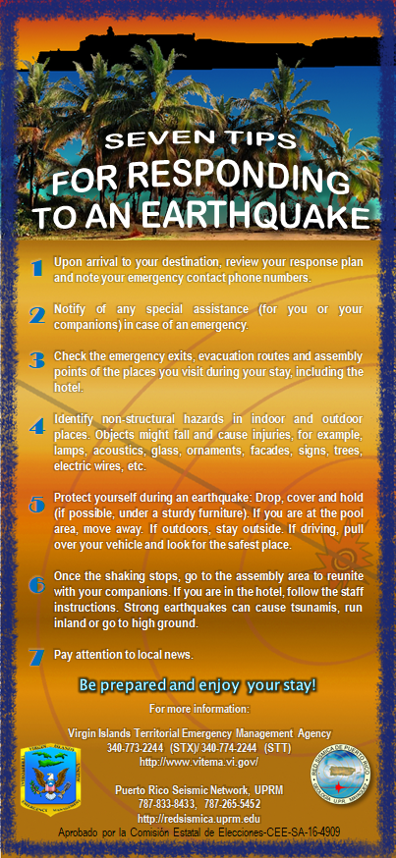
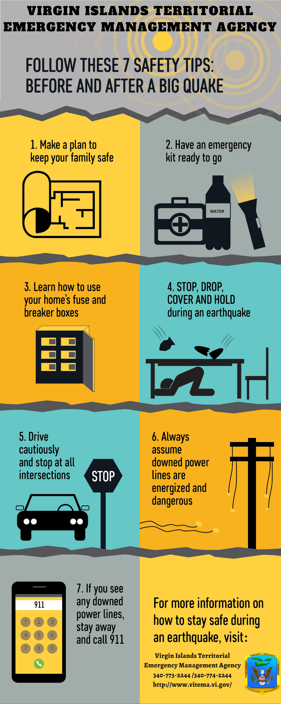
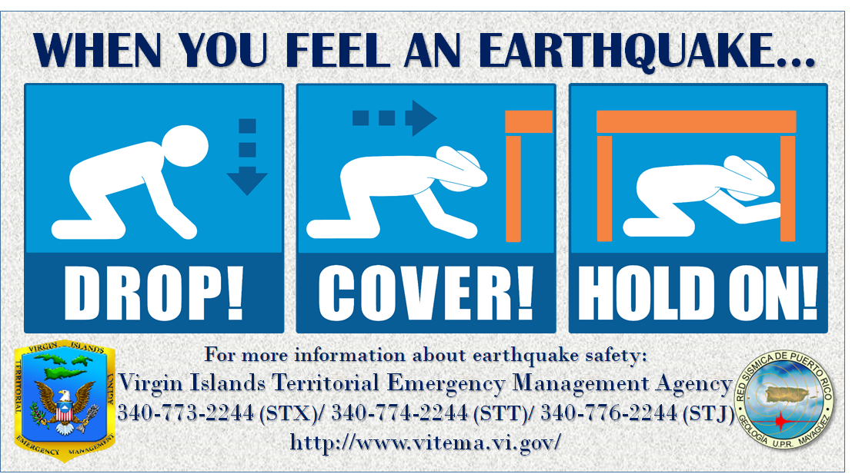
Earthquake Signage

Slide 16
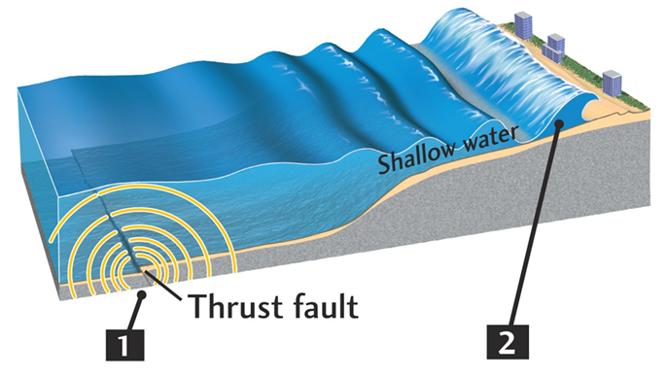
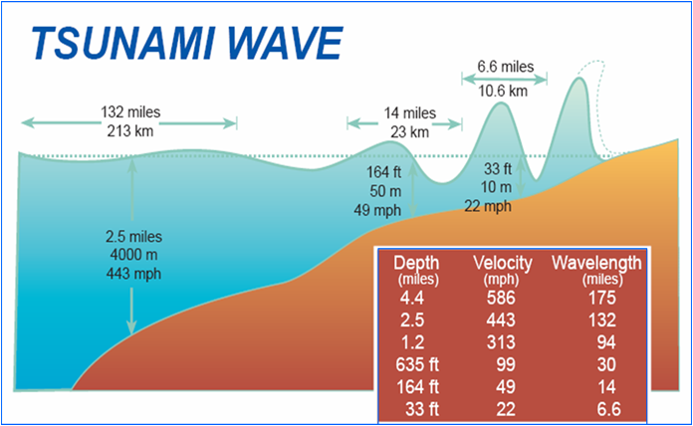
What is a Tsunami?
A tsunami consists of a series of ocean or sea waves that can be generated by an earthquake, volcanic eruption, landslide or meteoric impact.
In deep water, the tsunami can travel as fast as 500 miles per hour (equivalent to the speed of a commercial jet). Near the shore, however, a tsunami slows down, the distance between its waves decreases and the wave height increases.
People on beaches or in low coastal areas, need to be aware that a tsunami could arrive within minutes of a severe earthquake – and the danger period can continue for many hours. Tsunamis can occur any time of year, day or night. The wave height could be tens of feet destroying everything along its path, when flooding and when receding.

Slide 17
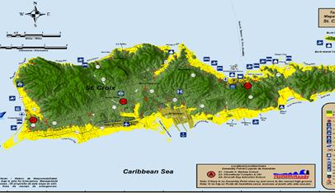
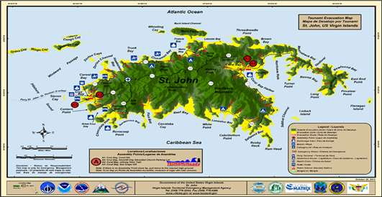
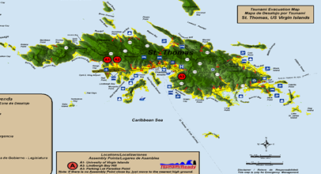
What To Do
Before a tsunami occurs:
PRACTICE your evacuation plan.
During a tsunami:
Stay away from the beach. If you can see the wave you are too close to escape it.
If the water is receding away from the shoreline this is nature's tsunami warning. Save yourself - not your possessions.
Follow the evacuation order issued by authorities and evacuate immediately. Take your animals with you. Move to higher ground 82 feet above sea level or go as far as 2 miles (3 kilometers) inland. If you cannot get this high or far, go as high or far as you can.
After a tsunami occurs:
Once safe, monitor local news reports via battery operated radio, TV, social media, and/or cell phone text alerts for emergency information and instructions.
Notes:
Stay away from glass, windows, outside doors and walls, and anything that could fall, such as light fixtures or furniture. Hold on to any sturdy covering so you can move with it until the shaking stops. Stay where you are until the shaking stops. Do not run outside
If you are trapped, do not move about or kick up dust. If you have a cell phone with you, use it to call or text for help. Tap on a pipe or wall or use a whistle, if you have one, so that rescuers can locate you.

Slide 18
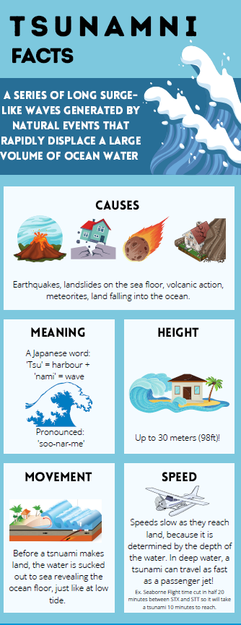
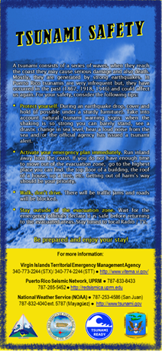
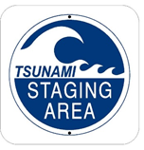
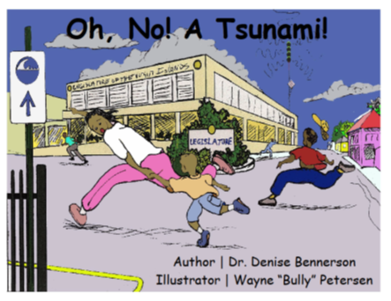
Tsunami Signage

Slide 19
What is an Active Shooter?
An Active Shooter is an individual actively engaged in killing or attempting to kill people in a confined and populated area.
It can happen anywhere. It can happen anytime.
Active shooter situations are unpredictable and evolve quickly.

Slide 20
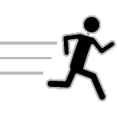
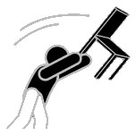
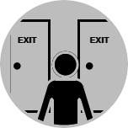
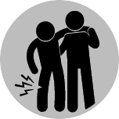
What to do during an Active Shooter event?
Run
Hide
Fight
See Something,
Say Something
Before You Run, Know the Exits
Learn First Aid
Skills
Call 911
(Help Law Enforcement)
Seek Help to Cope
With Trauma

Slide 21
VITEMA’s Preparedness Campaigns & Programs
National Preparedness Month
September 2021
The Great ShakeOut
October 21, 2021 at 10:21am
USVI Tsunami Awareness Week
November 1-5, 2021
Caribe Wave
March 10, 2022
Hurricane Preparedness Week
May 25-31, 2022

Slide 23
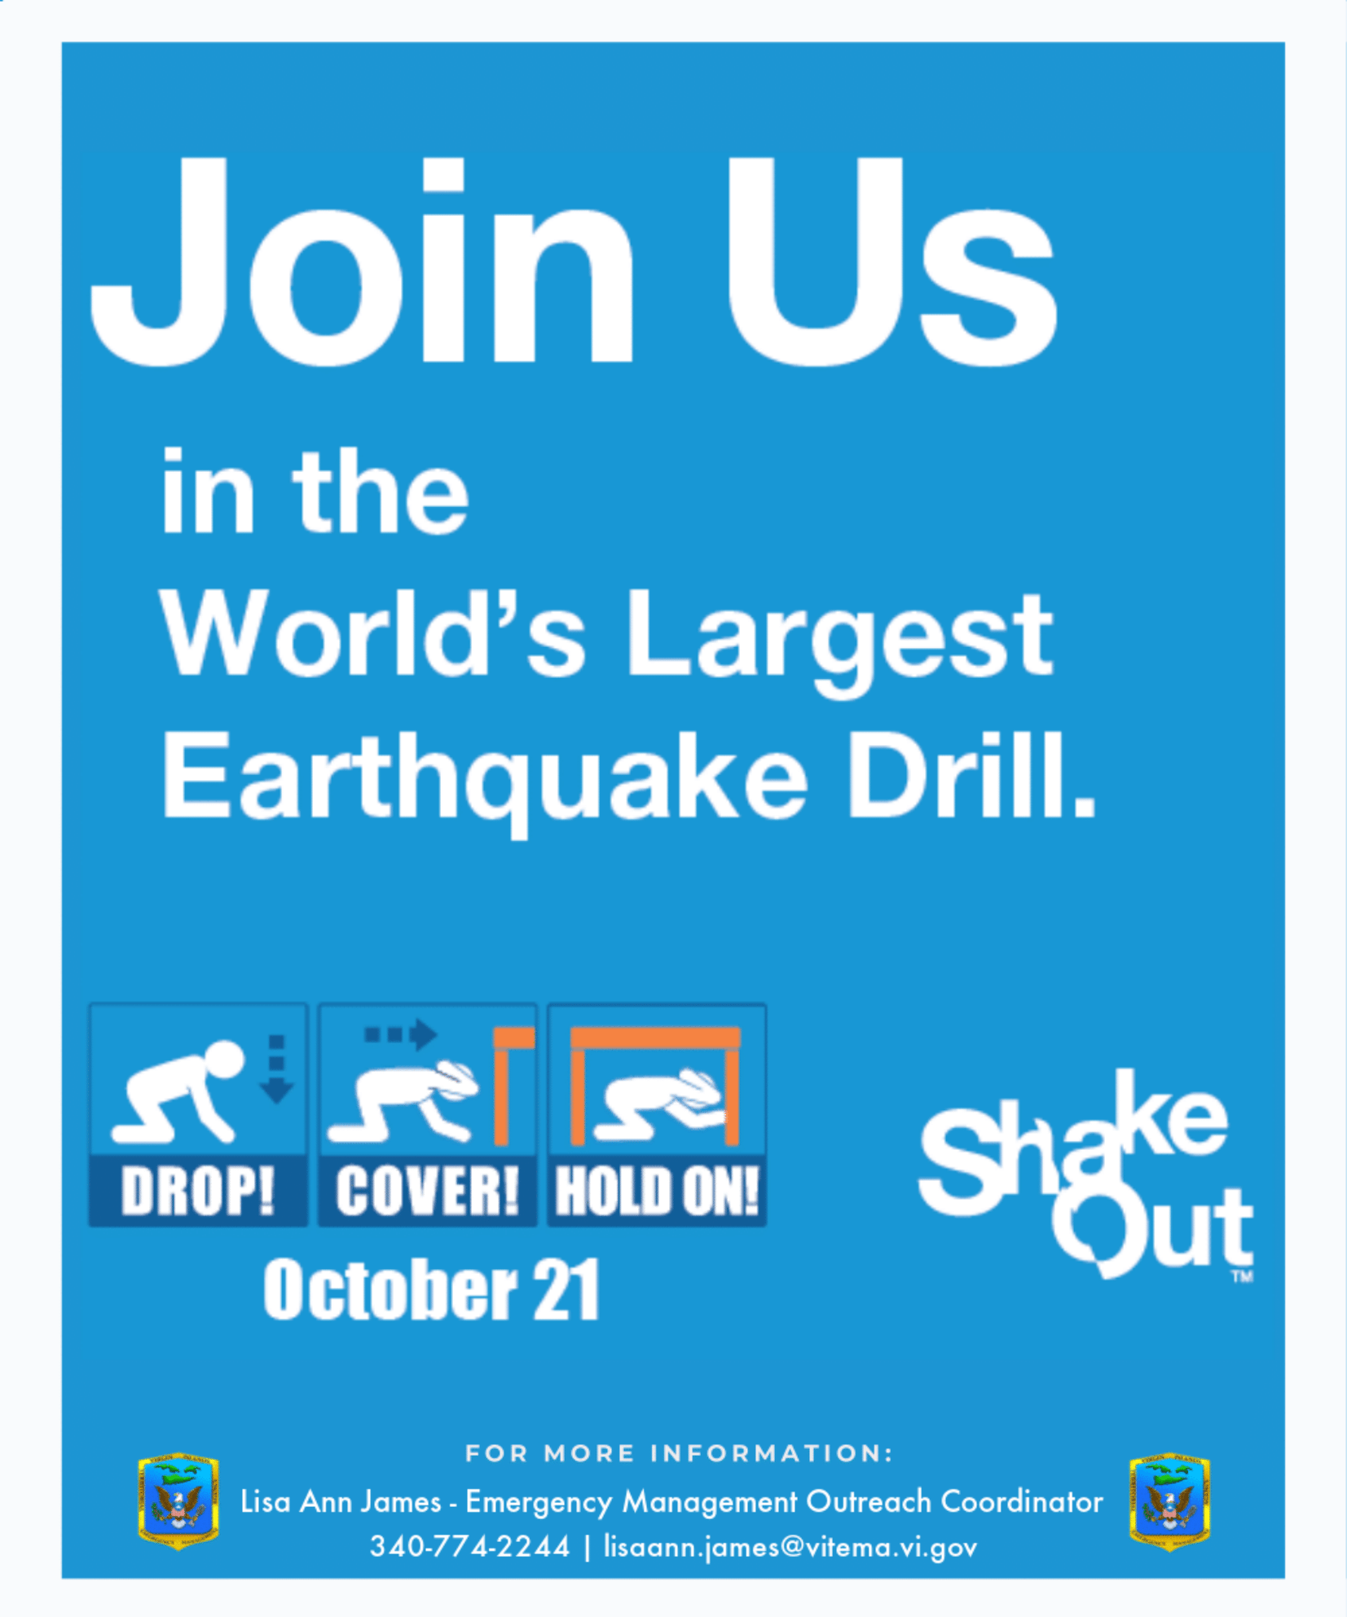
The Great ShakeOut October 21, 2021 at 10:21am
The Great ShakeOut is a nationwide annual earthquake drill focused on practicing how to be safer during earthquakes.
To register:
Contact Lisa Ann James by calling
340-774-2244 or email
lisaann.james@vitema.vi.gov
Online at
https://www.shakeout.org/howtoparticipate/

Slide 24
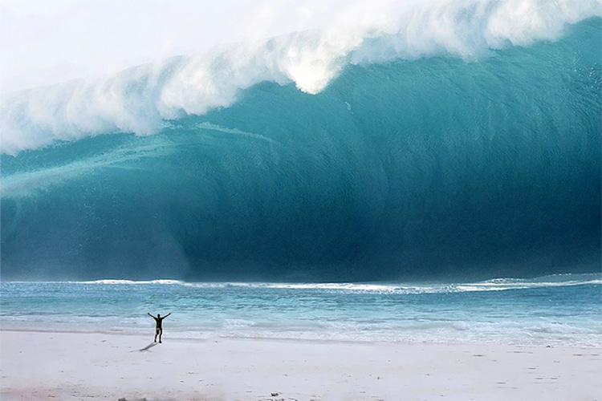
USVI Tsunami Awareness Week November 1-5, 2021
Tsunami Awareness week is focused on practicing how to survive a tsunami in The U.S. Virgin Islands.
For more information, visit VITEMA’s website at www.vitema.vi.gov
or https://www.tsunamizone.org/usvi/

Slide 25
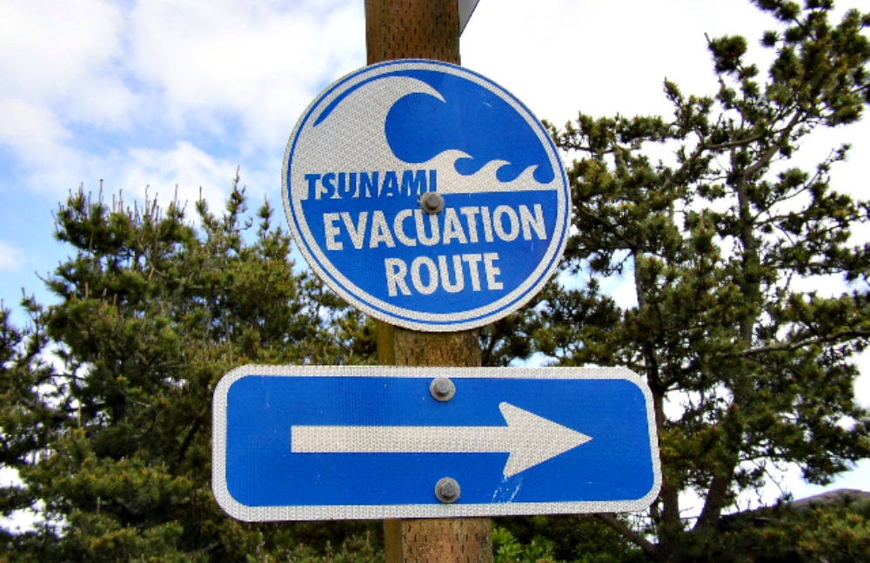
Caribe Wave March 10, 2022
CARIBE WAVE is the annual tsunami exercise utilized to advance tsunami preparedness efforts in the Caribbean and Adjacent Regions.
For more information, visit VITEMA’s website at www.vitema.vi.gov or
https://www.tsunamizone.org/caribewave/

Slide 26
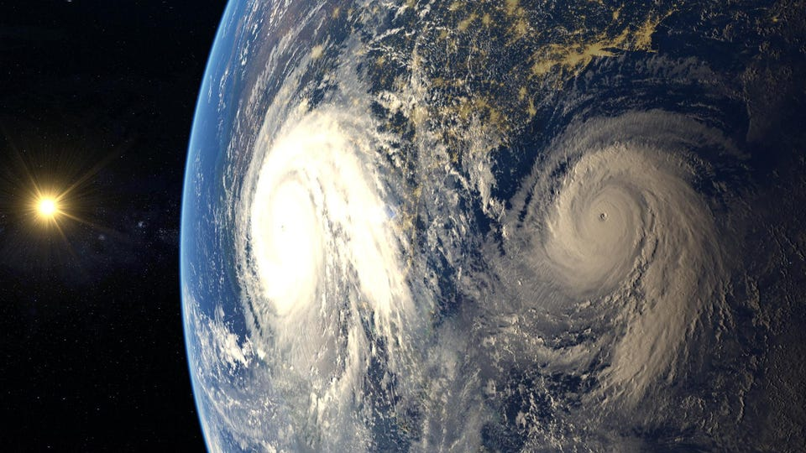
Hurricane Preparedness Week May 25-31, 2022
National Hurricane Preparedness Week is a nationwide effort to inform the public about hurricane hazards and to disseminate knowledge which can be used to prepare and take action.
For more information, visit www.vitema.vi.gov.

Slide 27
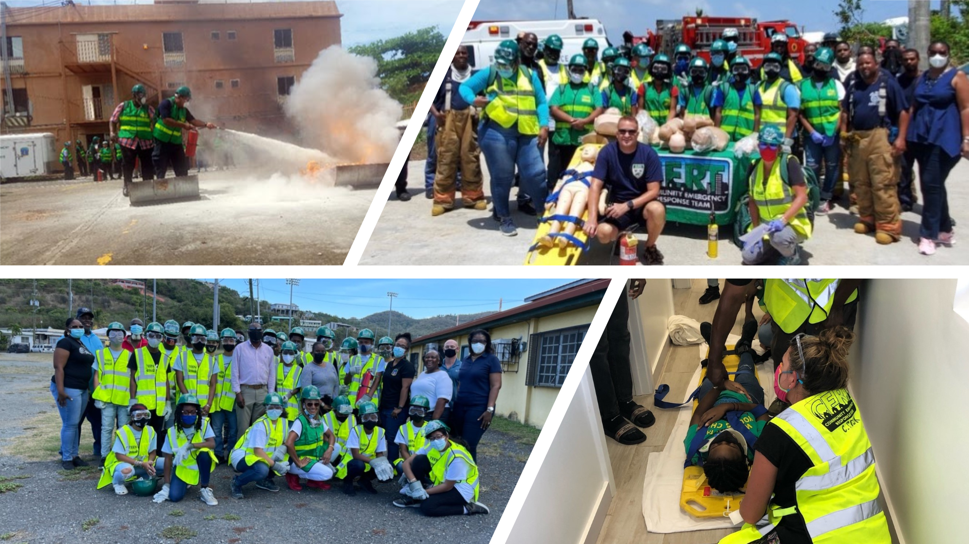
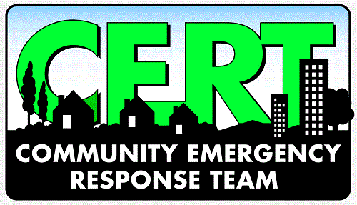
Community Emergency Response Team
The Community Emergency Response Team (CERT) program educates volunteers about disaster preparedness for the hazards that may impact their area. They receive training in basic disaster response skills such as fire safety, light search and rescue, team organization, and disaster medical operations.
CERT offers a consistent, nationwide approach to volunteer training and organization that professional responders can rely on during disaster situations.

Slide 28
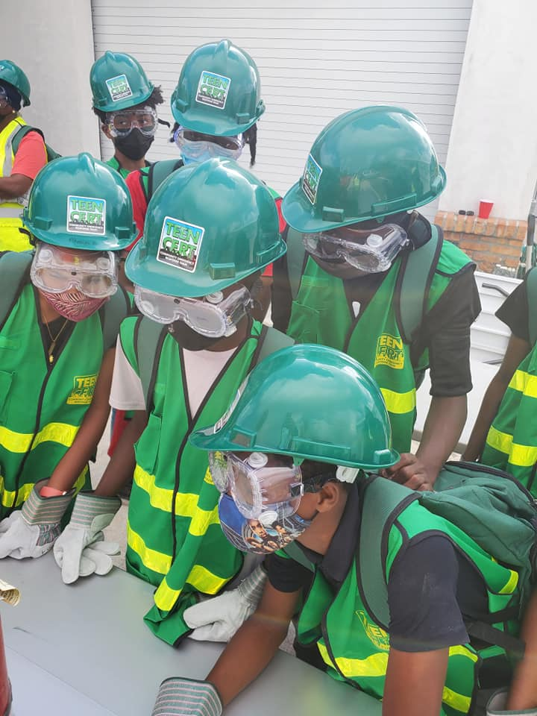
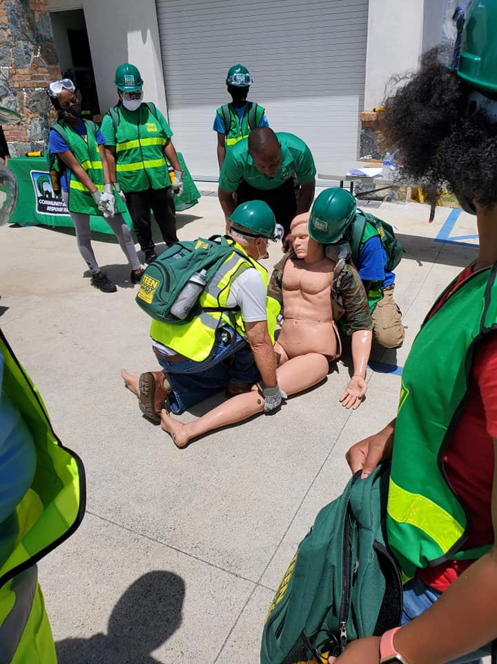
Become a CERT Volunteer!
To register for CERT classes, or to create your own CERT team within your organization, reach out to Lisa Ann James at lisaann.james@vitema.vi.gov.
Ages 12+ can register for Teen CERT.

Slide 29
HURRICANE SHELTERS FOR 2021 SEASON St. Thomas Bertha C. Boschulte Jr. High Lockhart Elementary School St. John Adrian Senior Center St. Croix St. Croix Educational Complex High School DC Canegata Community Center Water Island Fire House For additional info: 340-715-6935

Slide 30
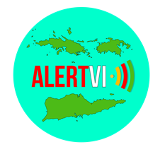
VITEMA encourages all residents to sign up for Alert VI, the Territorial mass notification system.
When you sign up with Alert VI you can enter up to five addresses within the Virgin Islands that you would like to receive emergency alerts about.
You can sign up with your cell phone to receive calls and/or text messages, your email address(es), home phone, business phone and hearing-impaired devices.
You can also download the Everbridge Public Safety app (free in the iOS, Android and Windows app stores).
Visit www.vitema.vi.gov to register in minutes.
Notes:
- Enter your home, work, relative, school or any other address that's important to you. Should an alert be issued for that location, you will receive a notification.

Slide 31
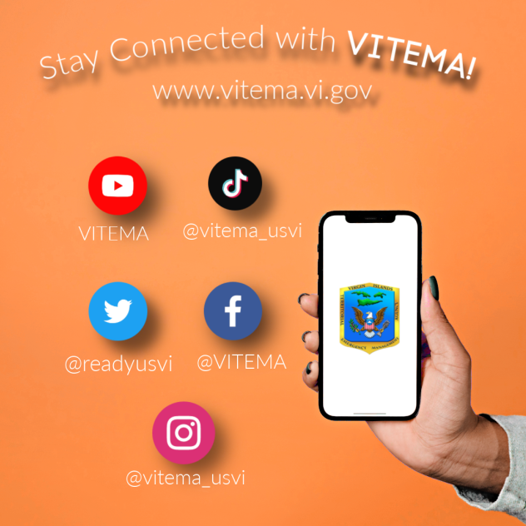
Stay Informed on the go!
Notes:
Good day everyone! My name is Meghan Beda, Media and Content Writer at VITEMA. VITEMA utilizes social media to regularly inform the community on different events, trainings, weather updates, and more. We’ve introduced our latest social platform, TikTok to engage the Territory’s youth in learning about hazard mitigation, response, recovery, and preparedness. So, if you have any young kids who are glued to their phones all day, let them know about our TikTok so that they can learn more about what we’ve discussed today as well.
We also have Facebook, Twitter, Instagram, and YouTube, all of which we update regularly to help everyone Stay Informed, which is one of our key points. Being informed is synonymous with wellness because in order to truly be well, you and your family must be safe and knowing what’s happening and how to protect yourselves is vital.

Slide 32
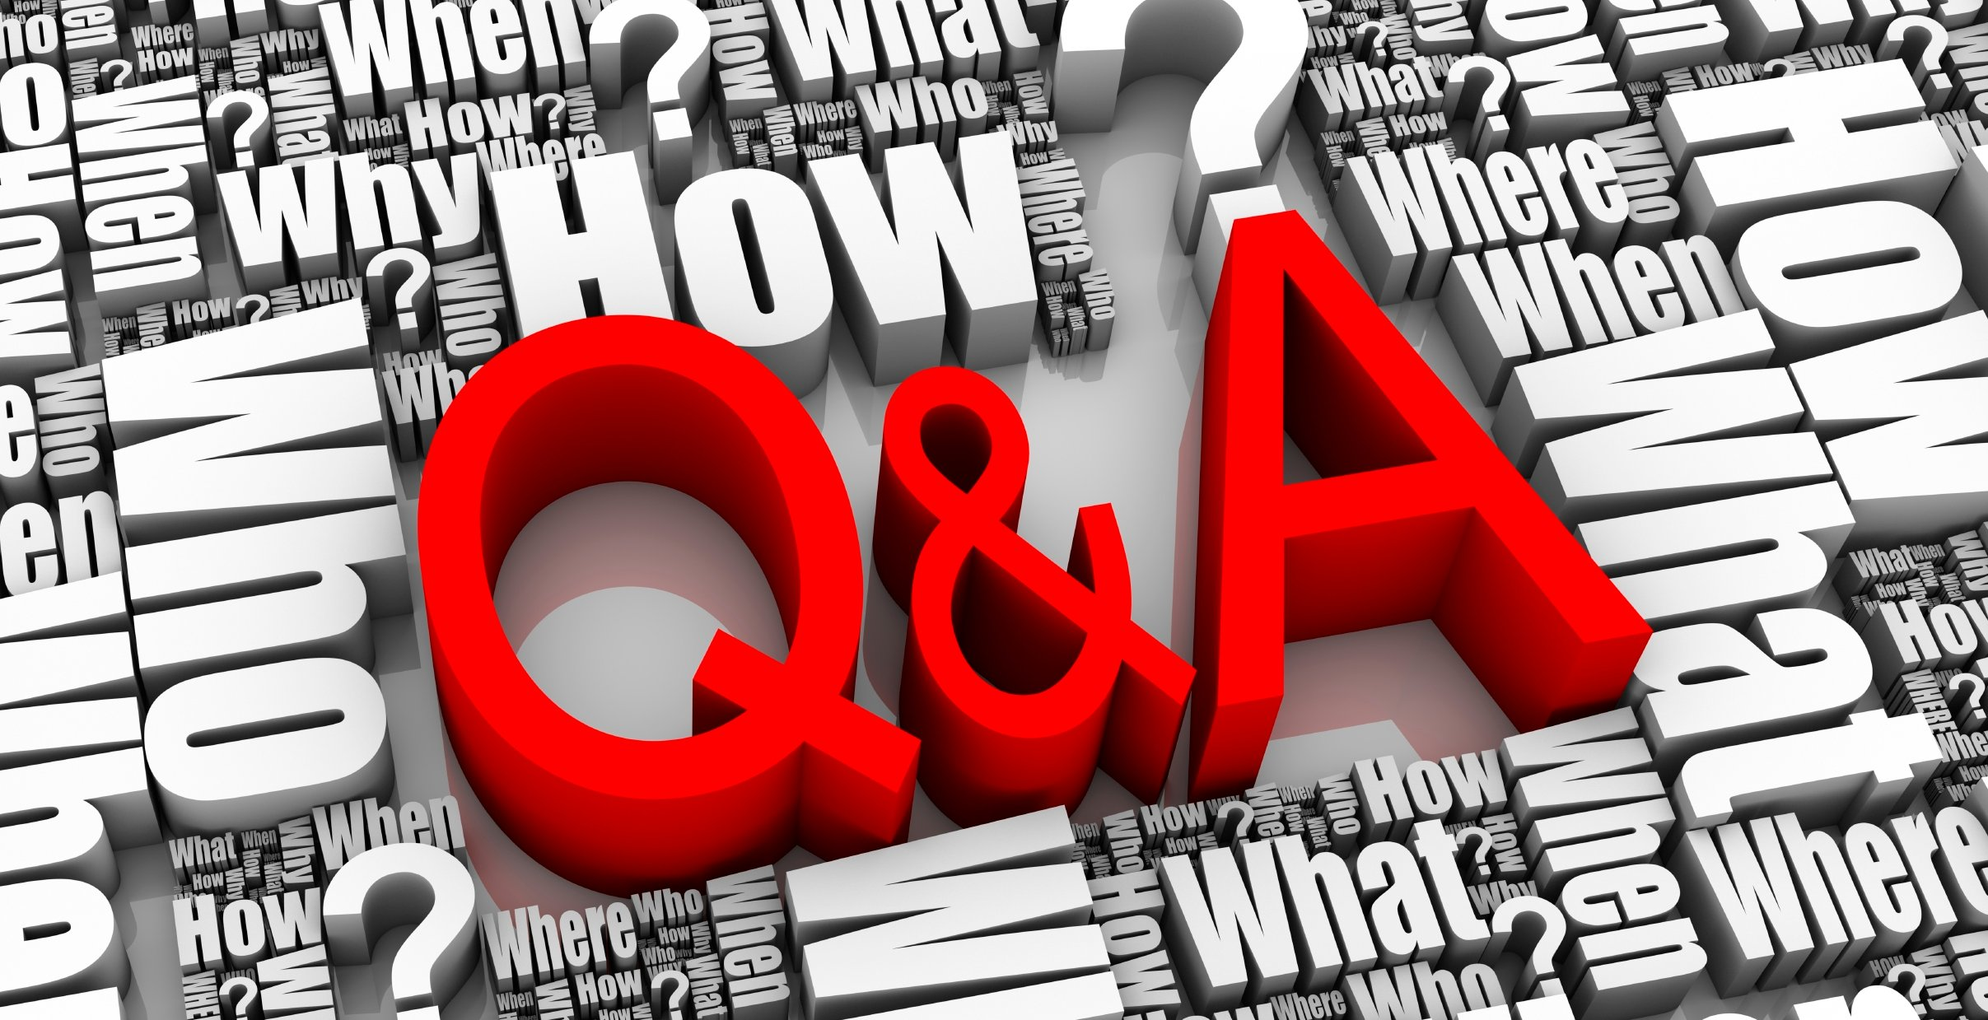

Slide 33
Contact Us
Be Prepared, Stay Informed, and Be Vigilant!
St. Thomas
8221 Estate Nisky
St. Thomas, VI 00802
Tel. 340-774-2244
St. Croix
2164 King Cross Street
Christiansted, VI 00820
Tel. 340-773-2244
St. John
6 Susannaberg
St. John, VI 00830
Tel. 340-776-2244
vitema.vi.gov

